Slide 1
PPG Meeting
18th July 2023

Slide 2
Staff Changes
Sadie & Kerry have left (pharmacy technician)
Julie is starting in August (pharmacy technician)
Grace and Gemma now Deputy PST Leads
Dr Phillips due to go on Maternity Leave
Max moved to care coordinator role
Dr Hana and Azam will be providing cover
Fiona, Linda, Olivia, Isabella joined PST
Niamh is doing an apprenticeship
Mel, Louise left PST
Pharmacy Network to provide pharmacist
Notes:
PCN Update & EA

Slide 3
ARRS New Roles
Care Co-Ordinator / GPA Joint Responsibilities
Champions for Carers & Veterans
Process Exercise & Weight Management Referrals for TR
Care Co-Ordinator
Active Signposting (With Nic W)
Arrange Cancer QOF Reviews
Care Home & Care Planning Support
Coil / Implant Consents
Deaf Awareness Lead
Monitor Lithium Patients
Recalls for Pessaries
GPA
Childhood Imms Ordering Support
DOAC Reviews
Dressing Ordering
GP Safety Alerts
Home BP Reading Averaging
Insulin Dose Change Waiting List
Medicines Reconciliation
Employment Support Allowance Forms
Personal Independence Payment (PIP) Forms
Practice Incoming Tasks / OOH Reports
Prescription Exemption Forms
Smear Results Filing

Slide 4
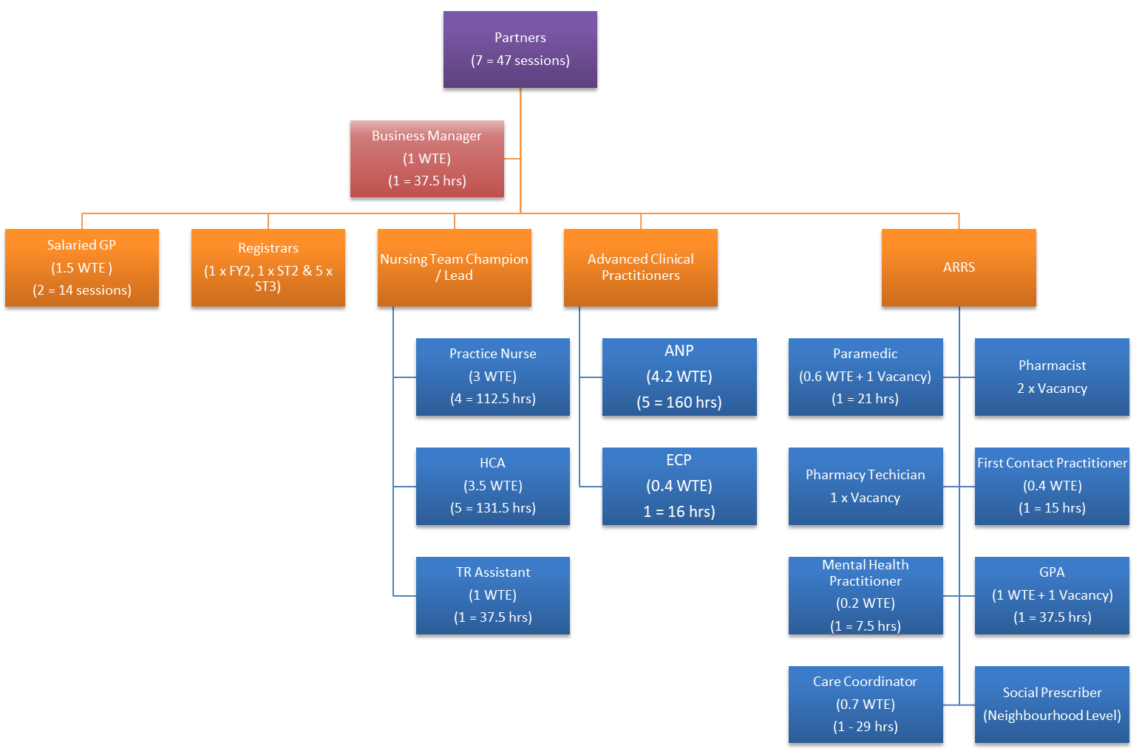
Structure Change

Slide 5
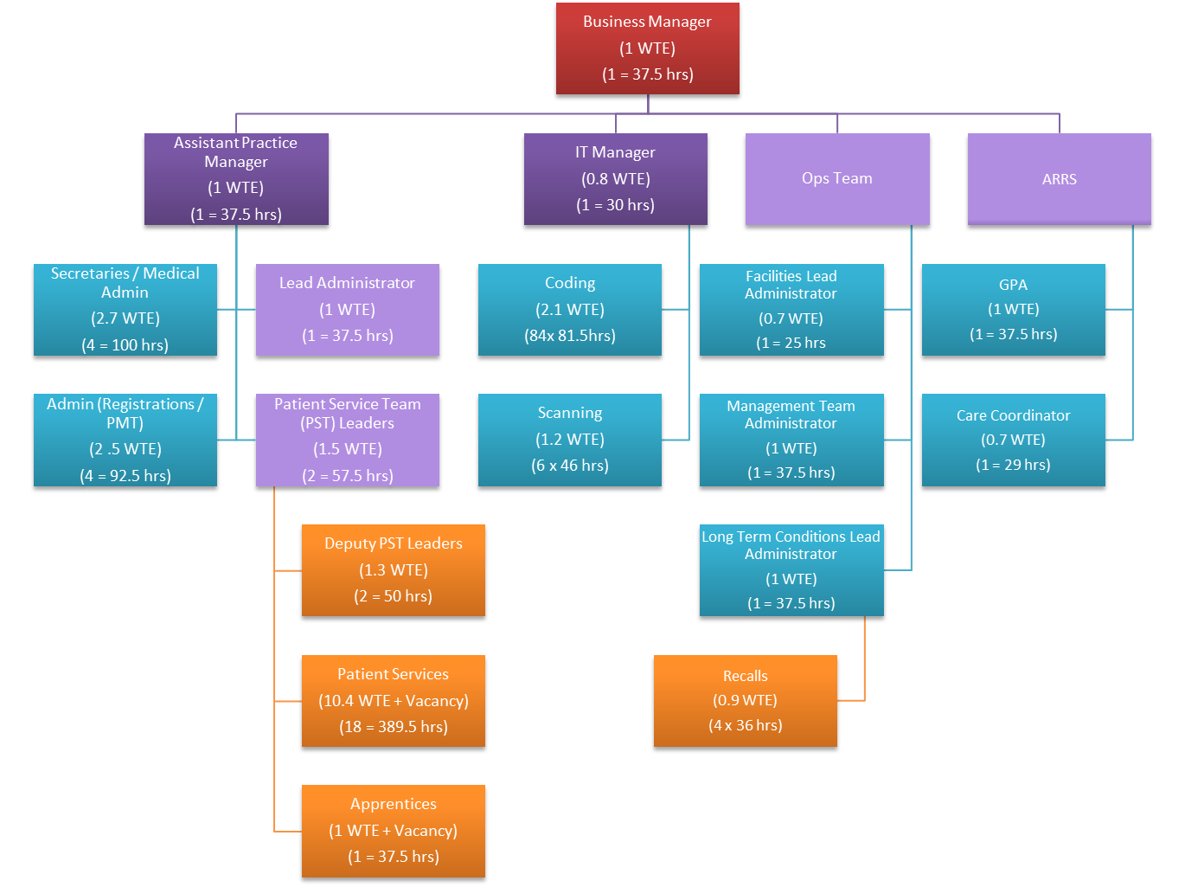
Structure Change

Slide 6
Structure Change - ACP
Spilt Supervision and Meetings from TR
Dr Jarram – clinical
Jennie Caukwell – HR / manager
Day to Day Support – duty Dr
Clinical Supervision – Dr Jarram
6 Month Post Appraisal Check In – as part of Clinical Supervision
New Starter Reviews 3 & 6 Months – Dr Jarram / Jennie Caukwell
Annual Appraisal – Dr Jarram / Jennie Caukwell

Slide 7
Structure Change - ACP
Clinical Supervision Updated To
Have regular time slot for supervision that is protected for 30 mins
Supervision discussion will be based on individual needs
Meeting frequency will be once every 2 months
Clinician to take notes so they can use as evidence for CPD / revalidation
Supplemented with ¼ly Group Catch Up
(educational - PLT)
¼ ly meeting to discuss any other issues

Slide 8
Structure Change – Nurses/HCAs
Support will be provided from within Ops Team
New Lead/Champion Role to be put into place
Role will be point of escalation, main representative at meetings, chair team meeting
Sarah TR Lead has Stepped Down

Slide 9
Structure Change – Nurses/HCAs
BLS training arranged by Mitch
Policy reviews coordinated by Mitch
Other mandatory training due Mitch will prompt & coordinate (if multiple staff)
Bluestream modules overdue/due added to Bluestream slot on S1
PGDs added to GP NET by Mitch
Action log updated by Mitch
Meeting chaired by Nurse Lead / Jennie / Pradeep
Agenda items collated by Mitch (will ask week beforehand)
Meetings dates arranged by Mitch
Minutes taken by Mitch

Slide 10
Structure Change – Nurses/HCAs
3 month and 6-month reviews coordinated by Mitch (Jennie/Pradeep)
HR support & issues picked up by Jennie
Annual Appraisal and 6-month check in coordinated by Mitch (Jennie/Pradeep)
Rota updated with slots blocked out for reviews/appraisal by Amanda
New starter/Student Nurse induction plans set up by Amanda (agreed with Jennie)
Competencies signed off (where required) as per practice process
Nurse/HCA to book onto course once agreed
Training and training plans agreed with Jennie
Training agreement put into place (where required) by Mitch
Rotas updated as per training plan by Amanda

Slide 11
Appointments Review
Saturated System Needs to Change
Reintroduce Sit & Wait
Refocus Ring Back Slots
Patient Education
Blood Results Process
Online Booking
Review Proportion of Prebookables
Duty Dr Task List
Active Signposting Reinvigorate

Slide 12
Online Consultations
LLR ICB funds our solution
Contract term came to an end
No option to extend contract
National procurement process had to be followed
3 solutions were made available
We could only pick one
Moved from Engage Consult to AccuRx 1st July
Still access through link on website
System is more streamlined, easier to use
Options for Admin, Medical, Sick notes and Prescriptions available
Medical page askes less questions
We have populated with self-referral options locally

Slide 13
Online Booking Proposal
Phased Approach to Reintroduction
Use remote booking for:-
Flu, Shingles, Pneumo
LTC
Smears
Phase 1 (June)
Smears
ANP 7.30-8.30 / 8.00-9.00
Registrars 14.00-15.00
Phase 2 (July)
Expand ANP slots
Expand Registrar slots
Phase 3 (August)
GPs
Pharmacist
Exclusions
GP Ringbacks slots
Nurse / HCA slots
Duty screen
Minor Surgery / Coils / Implants
Residential Homes

Slide 14
Appointments - ANPs
From 31st July 2023
PST less likely to make a mistake
Removes the need for double appts & catch ups
Adjust Slot Times to 15 Mins
Do a 3-month trial and we can re-audit
Move from 39 Appts to 32 Appts

Slide 15
Sit & Wait Sessions
Restarts from 7th August
8.00 to 10.30 & 13.30 – 15.00
Staffed by ANP, ECP, Paramedic or GP
HCA slots available alongside this for urgent bloods/ECG
If problem suitable for CPCS onward referral made
Single problem, too urgent to wait until next available appt
Breathing difficulties, lumps in breast, severe pain, chest infections, blood in stools
Patient added to list with reason, patients seen in order of priority

Slide 16
On Call Triage
Ring back only
Decline or struggling with Mental Health
Staffed by GP
Pain relief not working
Requesting a home visit
Declined a recent admission

Slide 17
Task Group for On Call Triage
Urgent query from patient
Urgent Medication Queries sent to PMT
Added to the urgent task session
EOL medications
Urgent authorisation for medication e.g. DN
Not for Med 3 complete template as normal

Slide 18
Other Appointments
MSK issue booked with FCP
Signposted to ED or 999 (life threatening)
Signposted to Community Pharmacy
Signposted to other service
Signposted to self-refer
Classed as routine offered next available appt

Slide 19
Abbreviations/Acronyms
ACP – Advanced Clinical Practitioner
ANP = Advanced Nurse Practitioner
ARRS – Additional Roles Reimbursement Scheme
BLS – Basic Life Support
CPD – Continued Professional Development
DN – District Nurse
DOAC – Direct Oral Anticoagulation
ECG - Electrocardiogram
ECP – Emergency Care Practitioner
ED – Emergency Department
FCP – First Contact Practitioner
GPA – General Practice Assistant
HCA - Health Care Assistant
HR – Human Resources
LLR – Leicester Leicestershire & Rutland
LTC – Long Term Condition
MSK – Musculoskeletal
OOH – Out of Hours
PGD – Patient Group Directive
PLT – Protected Learning Time
PMT – Prescription Management Team
PST – Patient Services Team
QOF – Quality & Outcomes Framework
TR - Treatment Room

