Slide 1
PPG Meeting
7th November 2023

Slide 2
Staff Changes
Alex joined as a paramedic
Izzy will move into GPA role from PST (to be advertised)
Sandie (nurse) now left (post advertised)
Abbie and Aimee joined PST
Sarah (ANP) now left
Chris (HCA) will retire at end of year
Jayne (HCA) will reduce hours (Jan)
Amy (GPA) now doing bloods
Notes:
PCN Update & EA

Slide 3
Flu Data, 27th October 2023
3152 (73%)
Over 65
1182 (42%)
Under 65

Slide 4
COVID Data, 27th October 2023
2210
Over 65
680
Under 65

Slide 5
Prospective Access to Medical Records
Took effect from 31st October and is contractual.
ALL patients aged 16 and over and have an online account in their own right will be given FULL PROSPECTIVE records access automatically.
Even if they only have access to order medication and book appointments.
This does not apply to patients with a proxy account i.e. parents with a proxy account will not have access to their child’s full record.

Slide 6
Prospective Access to Medical Records
You will see
Medical information added to your record from 31st October
Medical information from date you register with practice (after 31st Oct)
Consultations for clinicians working for the practice (inc. WFH)
Full text from the consultation
Letters
Test results and comments added to them
Scheduled Tasks
Admin notes
We may hide part of a consultation if we feel it may cause harm or distress

Slide 7
Prospective Access to Medical Records
Those with access to their historic detailed coded record this will not change
Patients with a history of DV, safeguarding concerns, lack mental capacity, will have access restricted
You will only see consultations added by the practice you are registered at
If you move practice ,you will only see information from the day you register
Previous practice information will not be viewable

Slide 8
Competency Sign Off
Competency Sign Off
Have started with HCA specific roles
Will expand to other areas for Nurses
Move to a consistent approach for all
Looking to pull this into one document

Slide 9
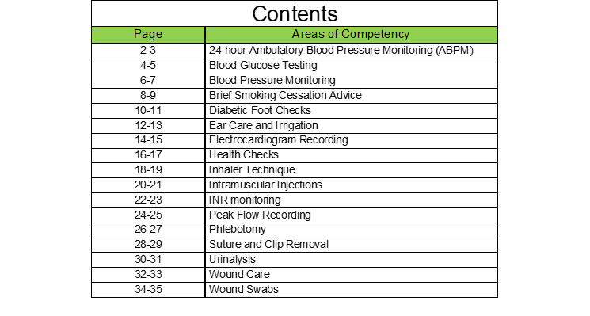
Competency Sign Off
Competency Sign Off

Slide 10
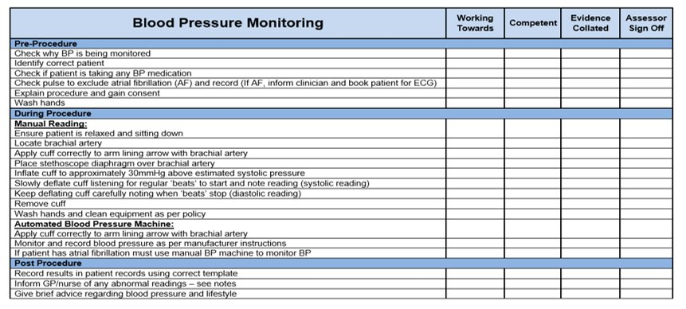
Competency Sign Off
Competency Sign Off

Slide 11
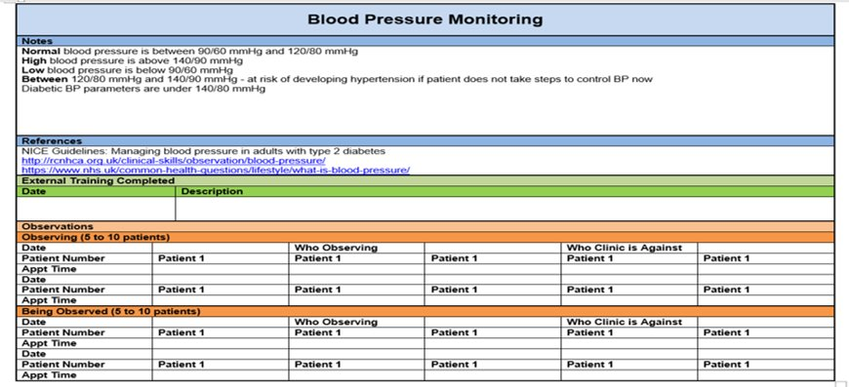
Competency Sign Off
Competency Sign Off

Slide 12
Competency Sign Off
Competency Sign Off
Drug stock spend has increased
Review stock levels to get these right
See if we can set up automated ordering in S1 (exclude childhood imms)
On occasion been over or under stocked
Zoladex 3.6mg
On average use 3 a month
Reduce max stock to 10
Max stock 20

Slide 13
Competency Sign Off
GP CAP
General Practice Contract Assurance Process
LLR ICB
Clinical leads and LMC input
Annual from 2023/24
ICB have a statutory duty to do this
CAP to capture required information
Review practice processes
Identify the good and where need to improve
Make recommendations
Comply with national guidance
Prepare for CQC
Complete by 10th November 2023

Slide 14
Competency Sign Off
GP CAP
General Practice Contract Assurance Process
Cover 5 key areas
GP CAP
Finance
Access
Estates
HR & Staff Management
Data Security & Business Continuity

Slide 15
PCN Engagement Meeting
Community Health and Wellbeing Plan
Year 2
Breast feeding
Dementia
LD
Year 1
Cancer prevention
Hip fracture prevention
Obesity/Overweight
MH
Background
Planning at district levels
Needs assessment, Workshops, survey and public engagement completed
Year 3
Carers
Diabetes

Slide 16
Abbreviations/Acronyms
ANP – Advanced Nurse Practitioner
DV – Domestic Violence
GPA – General Practice Assistant
HCA – Healthcare Assistant
LD – Learning Disabilities
MH – Mental Health
PST – Patient Services Team
S1 - SystmOne
WFH – Working From Home

