Slide 1


PPG Meeting
9th May 2023

Slide 2
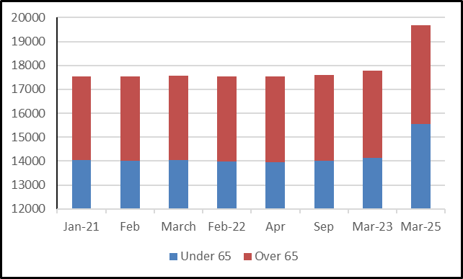
Patient Population
Month | Under 65 | Over 65 | Total
April 2019 | 12105 | 2955 | 15060
Feb 2020 | 14130 | 3676 | 17806
March 2021 | 14040 | 3524 | 17564
February 2022 | 13974 | 3567 | 17541
March 2023 | 14127 | 3650 | 17777
March 2025 | 15560 | 4130 | 19697
Patient list continues to grow
New building developments planned

Slide 3
Demand and Capacity
Phone calls average above 3000 per week
In addition to this we have emails, online consultations and face to face contacts

Slide 4
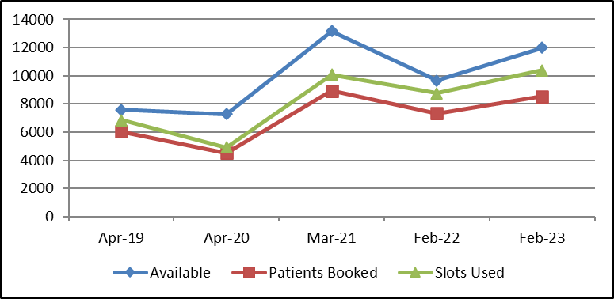
Demand and Capacity
OPEL Reporting
Demand has remained high
Problems more complex / multiple items
Patient expectations are high
Promotional items says go to your GP
Other services direct to GP
Patients reluctant to self care or manage
Patient collapses in waiting area
Patient needs admitting 4 hour wait for ambulance

Slide 5
Demand and Capacity
Sign prescriptions
Process tasks
Arrange referrals
Write reports e.g. coroner
Review diagnostic results (bloods, x-rays, ECG)
Read correspondence
Debrief clinical staff
Attend MDT meetings / case conferences
Arrange onward referrals
Appt data is flawed
Doesn’t reflect true picture of workload
Alongside seeing patients we have plenty else to manage
These items aren’t considered or shared

Slide 6
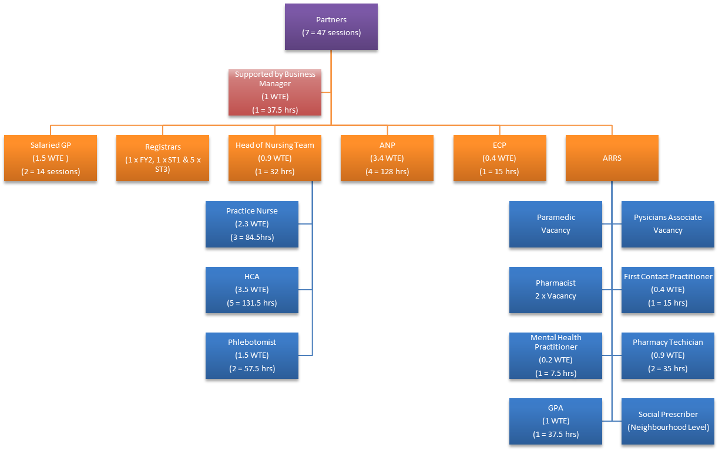
Clinical Structure
Key Changes:-
↓ in Partners Sessions
↑ in Salaried GP hours
↔ in Head of Nursing Team hours
↑ in ANP hours
↓ in Nurse hours (one vacancy)
↑ in HCA hours
↑ in Phlebotomy hours
↓ in Pharmacy hours – two vacancies
↑ in Pharmacy Technician hours
↑ in GPA new role
↑ in First Contact Practitioner hours
↔ in Mental Health Practitioner hours
ARRS made it competitive
Not enough trained staff
Limited pool of people
Internal development is important

Slide 7
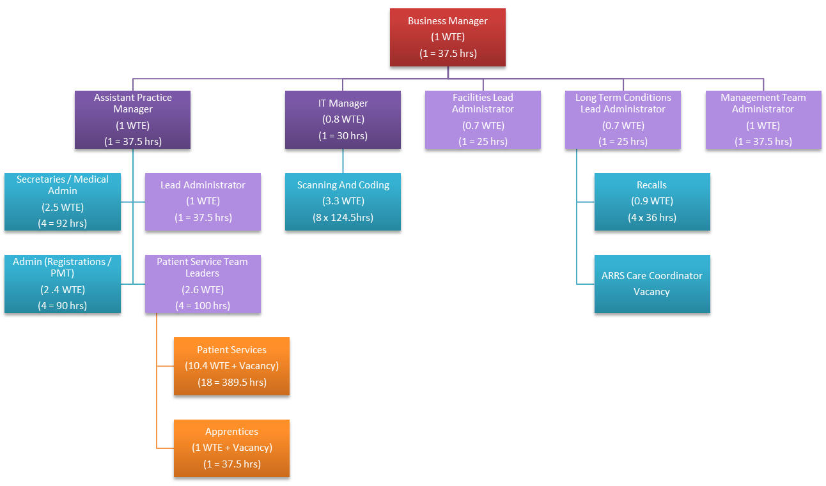
Admin Structure
How do you compete against other organisations
Living Wage goes up but not reflected in GMS contract payment
Key Changes:-
↑ in Manager/Ops Team Hours
↑ in Secretaries/Medical Admin hours
↑ in Scanning/Coding hours
↓ in Patient Services Team Leaders
↓ in Patient Services hours – one vacancy
↓ in Apprentices – one finished course

Slide 8
Managing Demand & Capacity
Using the teams skills effectively
Mix of bookable and on the day appointments
Online consultations, telephone and face to face available
Navigating patients to the right clinician
Actively signposting patients to self care or other more appropriate services
For some patients this is still not enough
Unrealistic national expectations (appt in 2 weeks)
Difficult to maintain Patient Safety
National and local media

Slide 9
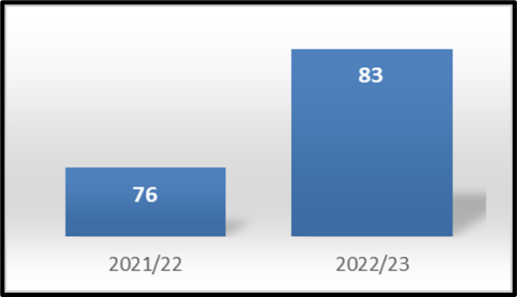
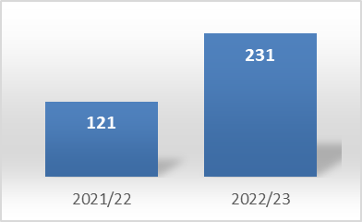
Achievement
Referrals to Community Pharmacy Consultation Service has increased
Social prescriber referrals embedded

Slide 10
Working Collectively
Two practice premises as nominated hubs
Centralised workforce available
All practices can access services being delivered
12 practice in North West Leicestershire formed as a Primary Care Network
Functionality and ability to offer services at scale

Slide 11
Working Collectively
Rotate between two locations
Offer GP, Minor Illness/Injury, Pharmacist Appointments
Supplement with bloods, smears, LTC reviews
Provide Covid vaccinations, ear syringing
Option 1​ | Week 1​ | Week 2​
Mon​ | Coalville​ | Ashby​
Tue​ | Ashby​ | Coalville​
Wed​ | Coalville​ | Ashby​
Thu​ | Ashby​ | Coalville​
Fri​ | Coalville​ | Ashby​
Sat​ | Ashby​ | Coalville​
Mon to Fri 6.30 to 830pm
Sat
9am to 5pm

Slide 12
Additional Askes
Directed Enhanced Services
Local Commissioned Services PH
ICB Incentives
PCN DES
Quality and Outcomes Framework

Slide 13
Additional Askes
LD HC
NHS HC
Flu
Covid
Shingles
Pneumo
Minor Surgery
Shared Care
Enhanced Diabetes
PQIS
Anticoagulation
Dressings
Ear Syringing
Examples

Slide 14
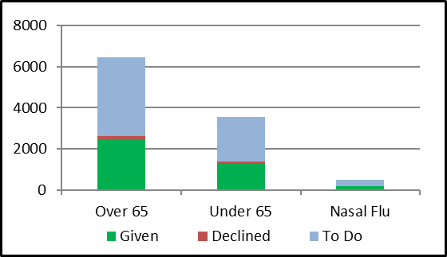
Additional Askes
Clinical Time =
259 hours
6.9 weeks
Flu Vaccinations
3891 flu vaccinations given by the practice
4333 flu vaccinations given elsewhere
Practice uptake has decreased slightly to 21/22
On Track for Impact and Investment Fund Targets
Childhood Screening figures have been on Target

Slide 15
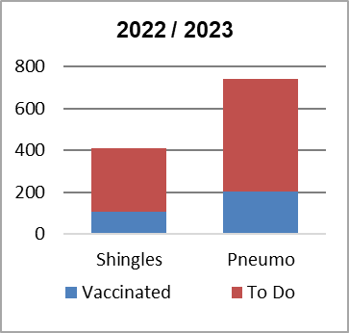
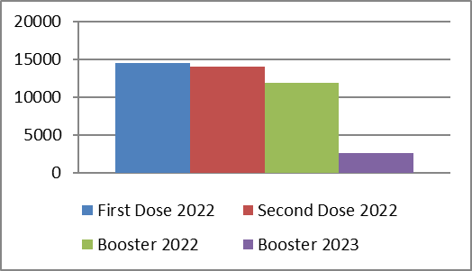
Achievement
Pneumo and Shingles uptake has decreased
Covid vaccinations great uptake

Slide 16
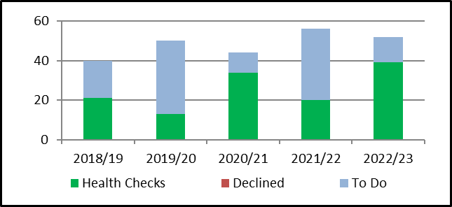
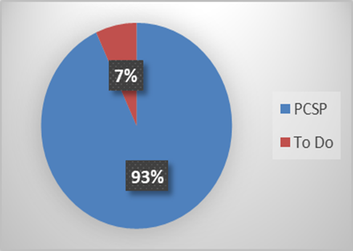
Achievement
Learning Disability Health Check uptake is being maintained and has improved
Care home patients have a personal care and support plan in place has increased
Clinical Time =
26 hours
Clinical Time =
54 hours

Slide 17
Premises Expansion
Is Section 106 money available
PID to ICB for approval
Draw plans up
DV evaluates rental value
Landlords review rental value
If no agreement rental value debated
Once agreed ICB approval

Slide 18
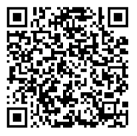
PPG Promotion
PPG Logo redrawn
CMG will host PPG page including minutes on website
PPG section on front screen and page on CMG website updated
Article in staff newsletter, social media and Ashby Life, to be promoted quarterly
Social media next meeting date to be promoted
Message to be sent out to promote PPG when get new registrations, text to be created
PPG information events to be arranged

