Slide 1
PPG Meeting
13th August 2024

Slide 2
Staff Changes
Alex left
(paramedic)
Helen joined
(PST)
Dr Phillips back in Sept
(salaried GP)
Tracey left
(PST)
Dr Hana left
(salaried GP)
Fiona joined
(Management Team Admin)
Sara left
(PST)
Change in Registrars
Anne Marie left (paramedic)

Slide 3
MH Pathways
Slight pause due to staff sickness
When contacting the practice, the team will ask a series of questions
One route in referral pathway for patients
From this they will navigate you to the correct service or clinician
Life changes signpost to JOY or SPLW
Under secondary care contact your MH clinician
Under CMHT contact them
Immediate risk 999, A&E, Duty Dr
Refer into the MHP
MHP will ring patient to triage them (48 urgent, 7-day routine)
They will signpost if appropriate
Book appt to see patient

Slide 4
New PCN Services
BP Monitoring
Optimising BP control (in addition to practice offer)
Target patients had a MI or Stroke who still have a raised BP
Travel Vaccinations
Overdue Smears
SMS sent to patients overdue
Offering an appointment in EA with a nurse
In addition to practice offer
Provide travel advice
Team will follow up with patient if no booking made
Women’s Health
In addition to practice offer
Extra access for patients needing a coil or implant
Those that complete 7-day BP offered an appointment in EA with a pharmacist
Sent an educational SMS and asked to complete 7-day BP
Administer NHS travel vaccinations (if required)
If successful will look to expand to private travel vaccinations
Team will offer support and advice (as required)
Offered an appointment in EA with a pharmacist

Slide 5
SPLW

Slide 6
Collective Action
Practices to implement as many as they wish
BMA vote results are in
98.3% voted in favour
List of 10 actions to choose from

Slide 7
GP Collective Action Survey
Limit daily patient counts per clinician to the UEMO recommended safe level (25)
Will we divert patients to urgent care once daily capacity has been reached
Stop engaging with eRS A&G pathways
Serve notice on any voluntary services that plug local commissioning gaps
Stop rationing referrals, investigations and admissions (refer etc when clinically appropriate, not use PRISM forms)
Switch off GP Connect Update Record functionality that permits data entry by third party providers
Withdraw permission for data sharing agreements that exclusively use data for secondary purposes (not direct care)
Freeze sign up to any new data sharing agreements or local system data sharing platforms
Switch off Meds Opt software embedded by the local ICB for financial savings
Defer signing declarations for completion for better digital telephony and simpler online requests (not share call volume data, online triage tools)
Defer making any decisions to support local or national NHSE pilot programmes

Slide 8
Government Announcements
6% pay uplift for staff
SFE being updated
Newly qualified GPs added to ARRS
Money to be ringfenced
Revised DES specification due out

Slide 9
Phone System
Make some changes
Call Back Functionality added
Options Menu
Contractual requirement
Call Back
30 seconds later option to press 8 to hold place in queue (put phone down)
After 1 minute reiterate position in the queue
Options Menu
New phone message added
Start small
When at position 1 you will be called back (we will hear it ringing out)
1 – Appt & All Enquires
2 – Prescription Queues (not to order)

Slide 10
Dressing Process
Dressing Classification
How to Access
Authorisation Required
Tier 1 (e.g. allevyn 7.5cm, k-band, mepore, tielle)
Tier 2 (e.g. allevyn 15cm, prontosan, silvercel)
Tier 3 (e.g. atrauman, NA, silfex)
None Required
None Required
TVN to Authorise
Stocked in practice (CU1)
Issue Acute Prescription
Stocked in practice (CU1)
Types of Dressing
Things to Consider
District Nurse Requests a Prescription
Patient asks for a Prescription
Other Services Ask us to Issue a Prescription
They have their own stock
If out of stock they can have some from our supply
Only issue acute prescription for Tier 3 (see above)
Check which Tier the items falls into
If Tier 1 / 2 patient to collect a supply from practice
If Tier 3 issue acute prescription (see above)
Check which Tier the item falls into
If Tier 1 / 2 patient to collect a supply from practice
If Tier 3 issue acute prescription (see above)

Slide 11
Vaccination Programmes
Covid
Flu
From 1st Oct (over 65 yrs, over 18yrs in clinical risk group, care homes, carers, close contact of immunocompromised patients, frontline workers)
Aged 75 – 79 yrs as of 31st Aug 2024
New Programme Respiratory Syncytial Virus
From 1st Sept (pregnant ladies, children aged 2-3 yrs, all children in clinical risk group)
Can co-administer with Flu
RSV
Turn 75 yrs on or after 1st Sept 2024
Remain eligible until 80th birthday
Pregnant ladies (at least 28 week)
We will be holding Sat Clinics (using one way system)
Support from the PPG would be appreciated
Plan to deliver alongside flu (where we can)
Care homes to be completed 1st week October
Over 65yrs, care homes, over 6 months in clinical risk group, frontline workers
Similar plan to last year
Stock dependant programme (supply not as consistent as Flu)

Slide 12
Patient Survey

Slide 13
Patient Survey
Above national average
Above ICS average
Can’t compare as questions changed
7 questions did improve
4 questions dropped

Slide 14
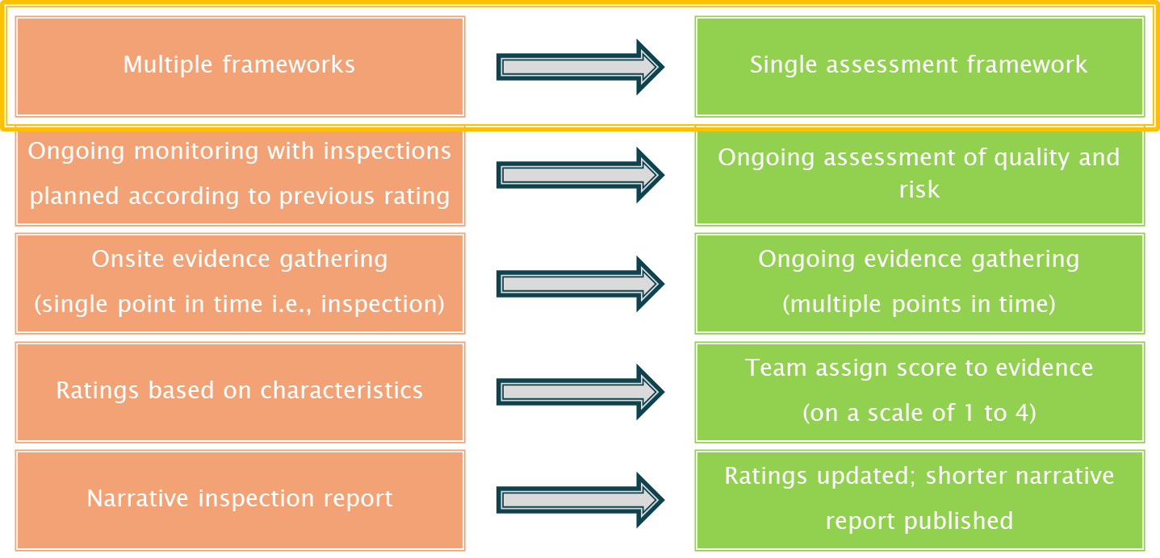
CQC – Overview of the changes

Slide 15
CQC – Single Assessment Framework Structure
5 key questions
6 evidence categories
Specific evidence & quality indicators
34 Quality Statements
Safe
Effective
Caring
Responsive
Well-led
Based on best practice
People’s experience
Staff & leaders feedback
Partner feedback
Observations
Process
Outcomes
Replacing KLOEs

Slide 16
CQC – Ongoing Assessment of Quality and Risk
Could be more frequent as part of an “ongoing assessment”
Could even be inspected again 6 months later
Practice will be notified of inspection with 2 weeks’ notice
Will have 8 days to provide evidence to CQC relating to the Quality Statements
Inspection could consist of a telephone call and in-house inspection
Prior to the inspection, a GP will remotely access the system to run searches for data

Slide 17
CQC – Ongoing Assessment of Quality and Risk
Safe
Learning Culture
Safe systems, pathways and transitions
Effective
Assessing needs
Delivering evidence-based care and treatment
Caring
Kindness, compassion and dignity
Independence, choice and control
Safeguarding
Involving people to manage risks
Safe environments
Safe and effective staffing
Infection prevention and control
Medicines optimisation
How staff, teams and services work together
Supporting people to live healthier lives
Monitoring and improving outcomes
Consent to care and treatment
Treating people as individuals
Responding to people’s immediate needs
Workforce wellbeing and enablement

Slide 18
CQC – Ongoing Assessment of Quality and Risk
Responsive
Person-centred care
Care provision, integration, and continuity
Well-led
Shared direction and culture
Capable, compassionate and inclusive leaders
Providing information
Listening to and involving people
Equity in access
Equity in experiences and outcomes
Planning for the future
Freedom to speak up
Workforce equality, diversity and inclusion
Governance, management and sustainability
Partnerships and communities
Learning, improvement and innovation
Environmental sustainability – sustainable development

Slide 19
CQC – Ongoing Assessment of Quality and Risk
Safe
Learning Culture
Safe systems, pathways and transitions
Safeguarding
Involving people to manage risks
Safe environments
Safe and effective staffing
Infection prevention and control
Medicines optimisation
Quality Statement
We have a proactive and positive culture of safety based on openness and honesty, in which concerns about safety are listened to, safety events are investigated and reported thoroughly, and lessons are learned to continually identify and embed good practices.
Appropriate evidence for this quality statement
Submitting SAEs, complaints, e-Learning
Providing significant events and complaints log – clear evidence of learning and changes which are discussed at meetings, etc.
Risk assessments

Slide 20
CQC – Ratings and Scoring
Outstanding
Good
Requires improvement
Inadequate
4 Evidence shows an exceptional standard of care
3 Evidence shows a good standard of care
2 Evidence shows shortfalls in the standard of care
1 Evidence shows a significant shortfall in the standard of care
CQC will apply a score to each evidence category, combining the quality statement scores to give an aggregate rating.

Slide 21
CQC – Determining a Rating
Quality Statement
e.g., “We assess and manage the risk of infection. We detect and control the risk of it spreading and share any concerns with appropriate agencies promptly”
Evidence categories
People’s experiences; Feedback from staff and leaders; Observations; Processes
Individual pieces of evidence
People’s experience – GP patient survey, compliments and complaints, friends and family responses
Feedback from staff and leaders – a call to speak with staff at the GP practice, an inspection to look at the care environment

Slide 22
6 evidence categories
CQC – Determining a Rating
People’s experience | 3 / 4
Staff & leaders feedback | 2 / 4
Partner feedback
Observations | 3 / 4
Process | 3 / 4
Outcomes
Total score | 11 / 16
69%
25 to 38% = | 1
39 to 62% = | 2
63 to 87% = | 3
Over 87% = | 4

Slide 23
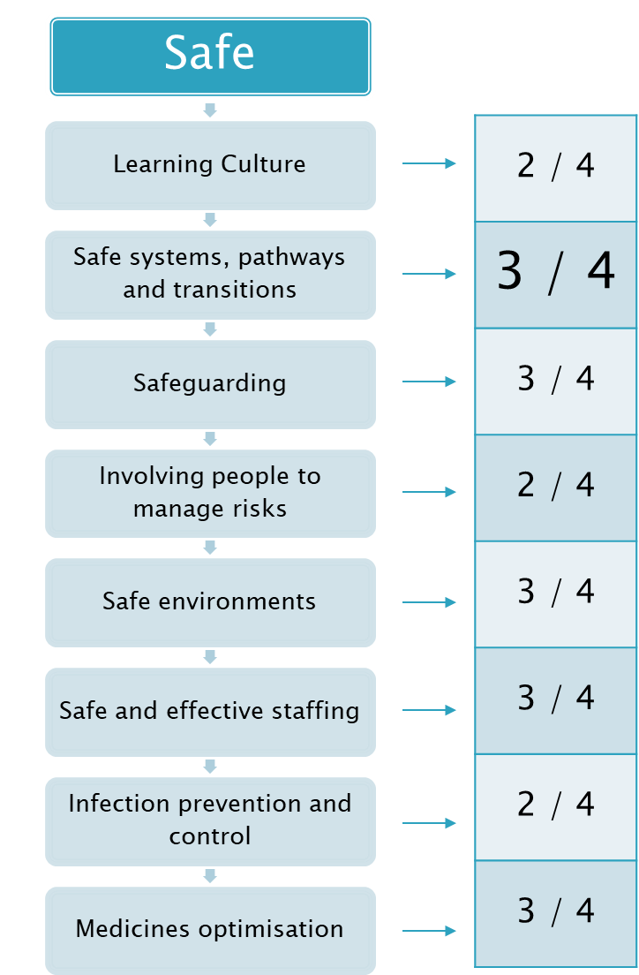
CQC – Determining a Rating
21 / 32
65.6%
25 to 38% = | Inadequate
39 to 62% = | Requires improvement
63 to 87% = | Good
Over 87% = | Outstanding

Slide 24
CQC – Overall Rating
Rating for each key question
Aggregate scores for key questions
Overall rating
Key question | Rating
Safe | Good
Effective | Good
Caring | Requires improvement
Responsive | Good
Well-led | Good
Aggregate
21 / 32
18 / 24
10 / 20
21 / 28
24 / 32
94 / 136
94 / 136 x 100 = 69.18%
Good

Slide 25
Acronyms
DES
Direct Enhanced Services
ARRS
Additional Roles Reimbursement Scheme
MMR
Measles, Mumps, Rubella
ICB
Integrated Care Board
MDT
Multi-Disciplinary Team
EA
Enhanced Access
MHP
Mental Health Practitioner
PST
Patient Services Team
CMHT
Community Mental Health Team
SPLW
Social Prescriber Link Worker
NHSE
NHS England
SMS
Short Message Service
BP
Blood Pressure
BMA
British Medical Association
A&G
Advice and Guidance
eRS
Electronic Referrals
SFE
Statement of Financial Entitlements
TVN
Tissue Viability Nurse
CU
Clean Utility

