Slide 1
PPG Meeting
19th November 2024

Slide 2
Staff Changes
Praise joining Dec
(apprentice)
Tommy joining Dec
(apprentice)
Advertised
(salaried GP)

Slide 3
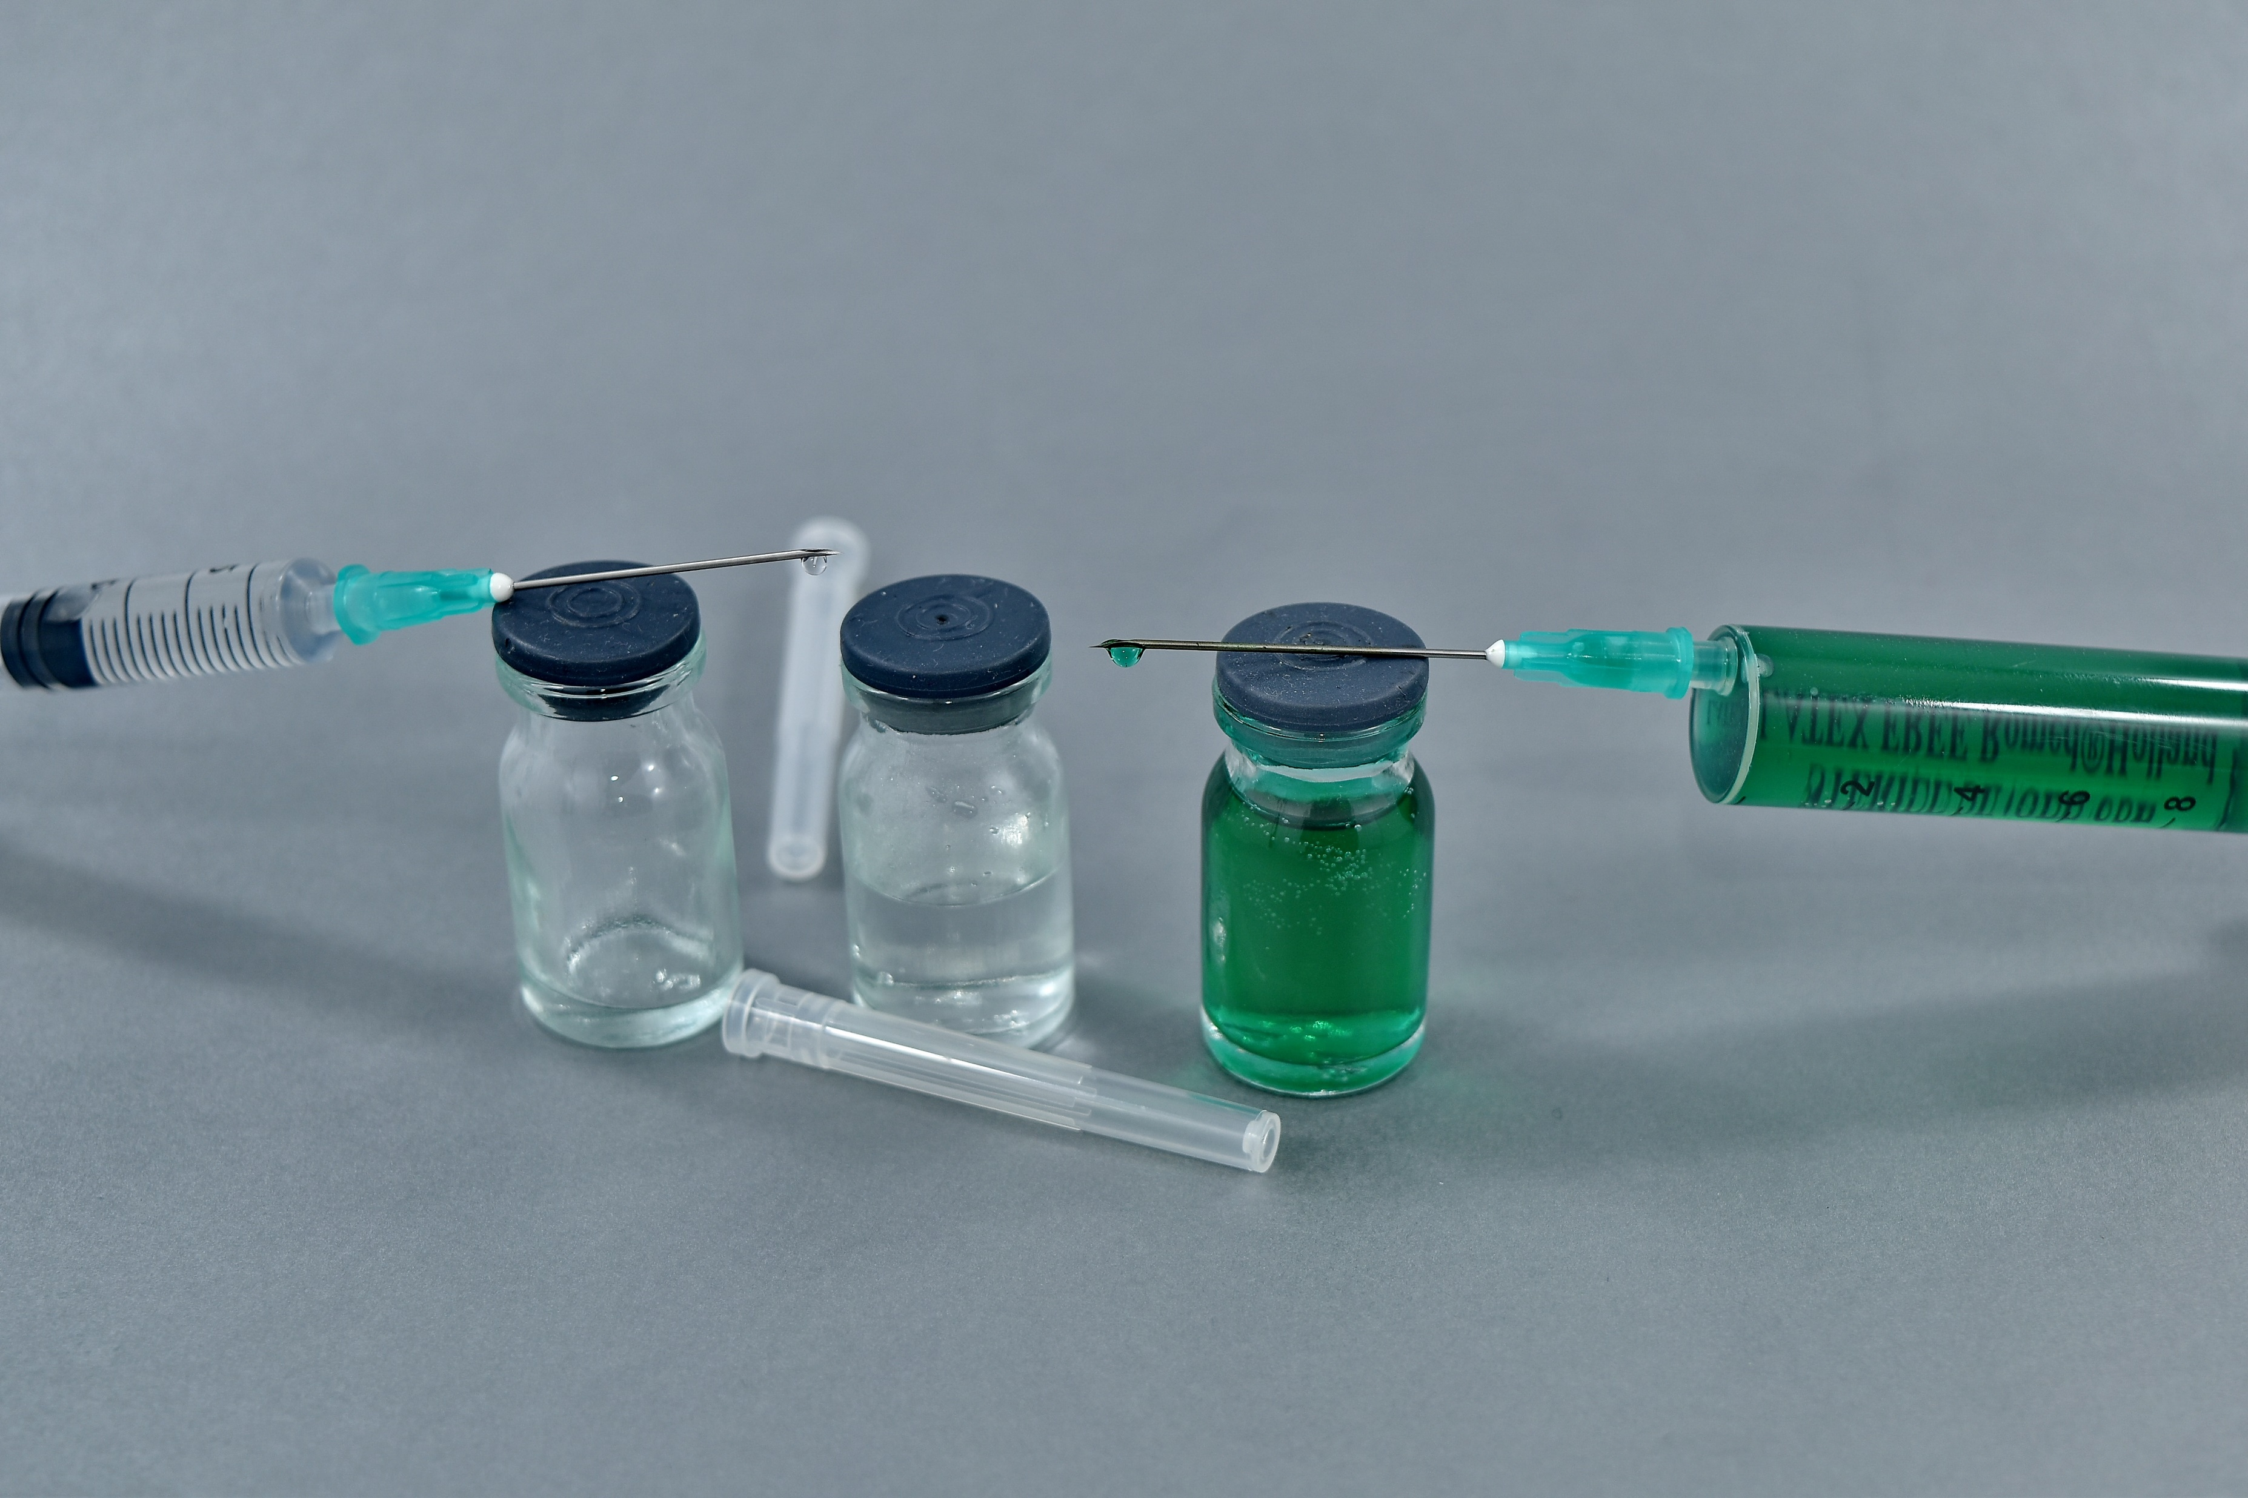
Other Vaccinations
Flu
3153 – adult (46%)
193 – child (59%)
Covid
3739 (21%)
RSV
445 (45%)

Slide 4
Appointment Changes
Phase 1
Sit & Wait
Go live from 28th October
Appointment numbers will be restricted
Once full we sign post (no extras)
AM = 15
PM = 10
Total = 25 per day per clinician
If 2 clinicians
AM = 30
PM = 20
Total = 50

Slide 5
Appointment Changes
Phase 1
Duty List
Go live from 28th October
Appointment numbers will be restricted
Once full we sign post (no extras unless on-call GP agrees – urgent cases only)
AM = 15
PM = 10
Total = 25 per day
+ 111 slots (only to be used by 111)
No change to task list

Slide 6
Appointment Changes
Phase 2
Triage Dr to Book Slots
Triage Dr to Book slots changed to:-
ANP = On The Day
Registrars = New Problem Slot
Go live 25th November
Reducing Triage Dr to Book slots
AM = 10
PM = 8
Total = 18 per day
Added to Partner Rotas first
If not enough partners added to Salaried GPs next, then registrars
Jennie Caukwell

Slide 7
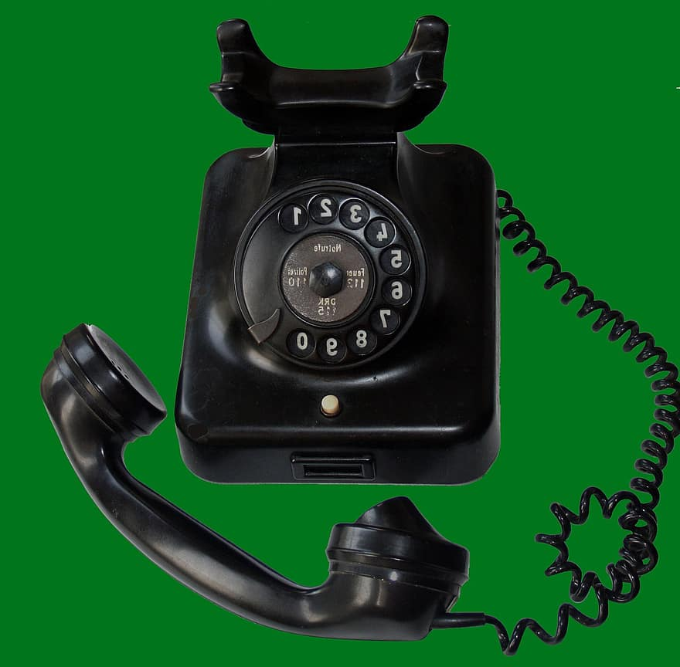
Appointment Changes
Phase 2
Partners & Salaried GPs
Registrar appointments unchanged (as under 25 per day)
Appointment numbers will be restricted
Once full we sign post (no extras unless on-call GP agrees – urgent cases only)
AM = 13
PM = 12
Total = 25 per day
(extra admin slots added)
No change to ring backs / clinical admin slots
Jennie Caukwell

Slide 8
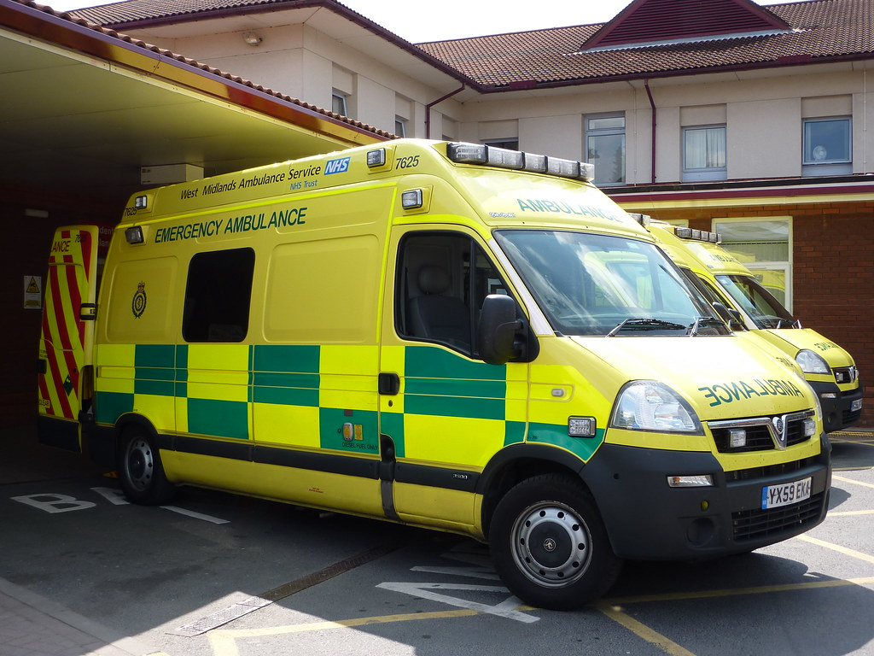
Collective Action – Options when Full
MSK book with FCP
MH consider MHP
Signpost to ED or 999 (if life threatening)
Signpost to Pharmacy or Pharmacy First referral
Signpost to self-refer
Signpost to UCC, 111 or 111 online
Offer next available appt
Enhanced Access
Jennie Caukwell

Slide 9
ARI / HVS
New
Winter Pressures
PCN funded
ARI
Mon to Fri
16.30 to 18.30
HVS
Mon to Fri
09.00 to 15.00
In addition to DHU HVS
Coughs, respiratory illness
Aged 3 months plus
At risk of hospital admission, frail, recently discharged

Slide 10
Nurse / HCA Appointments
7.5 Mins
Bloods
INRs
10 Mins
B12
Hormone Injections
Inclisiran
Pneumonia
Ear Check
Shingles
Tetanus
15 Mins
22.5 Mins
Baby Clinic
Coil Checks/Removals
HRT New/Review
Review (Asthma, DM, Stroke)
GPCOG
Contraception Injections
Dressings F/Up
ECG
Insulin Dose Changes
Insulin Starts
Diabetic Foot Check
Smears
Travel Questionnaire Review
30 Mins
Dressing First Appt
Dressings x 2 wounds
LD Review
Swabs (DNA, Wound, Ear)
Wound First Assessment
Whooping Cough
Removal of Sutures/Clips >20
Removal of Sutures/Clips <20
Pill Check
Burns
BP Checks Use Machine in Waiting Area or Home BP Machine
Flu / Nasal Flu / Covid Set Clinics
Prediabetes and NHS HC TBC (new process using AccuRx to F/Up

Slide 11
fundraising - autumn
Tombola
Cake Sale
£781.44
Cycling Challenge
Guess Pudsey’s BD

Slide 12
Acronyms
ED
Emergency Department
F/Up
Follow Up
HVS
Home Visiting Service
UCC
Urgent Care Centre
BD
Birthday
HCA
Health Care Assistant
ARI
Acute Respiratory Infections
RSV
Respiratory Syncytial Virus
ANP
Advance Nurse Practitioner
FCP
First Contact Practitioner
MSK
Musculoskeletal Health
MH
Mental Health
MHP
Mental Health Practitioner
PCN
Primary Care Network

